Slide 1
Connecting the Dots: Mathematical Tasks to Build an Understanding of Functions
Barbara Kuehl, Salt Lake City School District
Scott Hendrickson, Brigham Young University

Slide 2
The Context for Growing Dots
Professional development seminar for teachers to experience functions in a new way.
Ten three-hour sessions with readings and assignments.
Each session had a pedagogical goal and a mathematical goal

Slide 3
Goals for Seminar
To develop mathematical understanding based upon connecting various representations-algebraic, geometric, numeric, graphical, story context
To experience problem-based pedagogy with discussion of rich tasks designed to elicit big mathematical ideas
To challenge the static view of functions and develop a more dynamic view

Slide 4
Sources for Tasks
Tasks were modified and extended from:
Learning and Teaching Linear Functions, Nanette Seago, Judith Mumme, Nicholas Branca
Developing Mathematical Ideas: Patterns, Functions, and Change, Deborah Schifter, Virginia Bastable, Susan Jo Russell
Interactive Mathematics Project, Year 4: High Dive and The World of Functions, Lynn Alper, Dan Fendel, Sherry Fraser, Diane Resek
Tasks were facilitated with different purposes than the authors’ original intent.

Slide 5
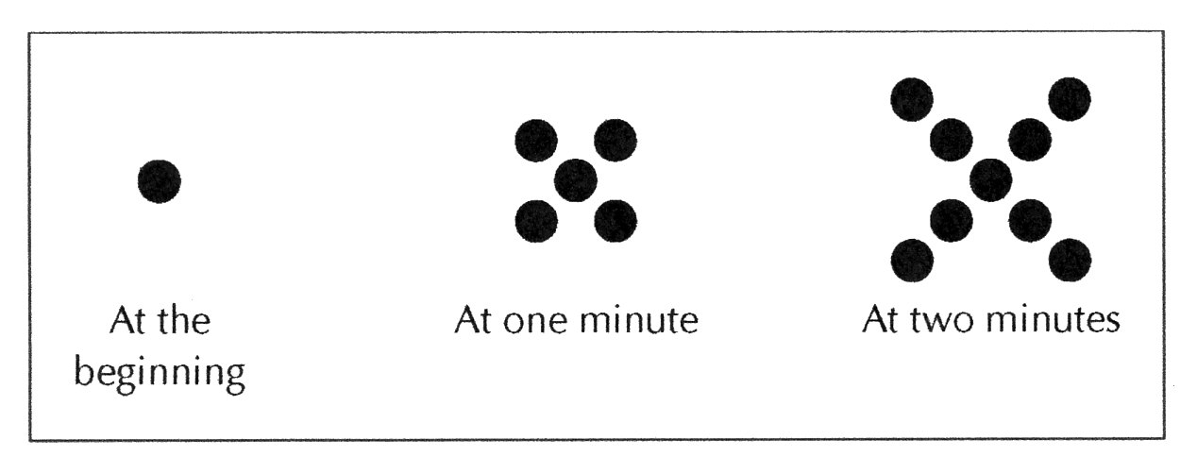
Growing Dots
Describe the pattern that you see in the above sequence of figures. Assuming the sequence continues in the same way, how many dots are there at 3 minutes? 100 minutes? t minutes?

Slide 6
Your Strategies
Notes:
Want to look at how the notation captures the participants’ words
How the different counting strategies highlight what’s changing and what’s staying the same
Recursive vs explicit and connections between functions and sequences

Slide 7
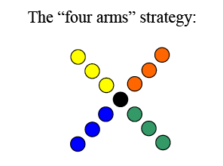
Strategy A

Slide 8
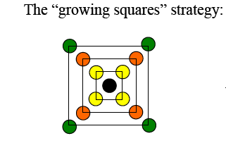
Strategy B

Slide 9
Strategy C

Slide 10
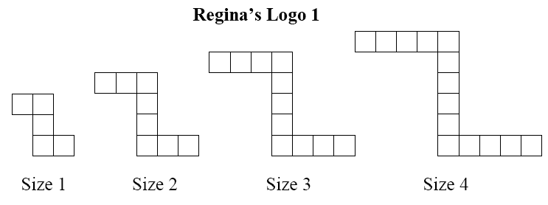
Regina’s Logo
For the following sequences of figures, assume the pattern continues to grow in the same manner. Find a rule or formula to determine the number of tiles in any size figure for that sequence.

Slide 11
Your Strategies
Notes:
Attending to the story – each equation tells a story
Constant rate of growth
What does the 3 represent in the story
What’s changing and what’s not
Where is the 3 – is the 3 groups of size 3 or 3 groups of something?
Where is the 2 in the logo?

Slide 12
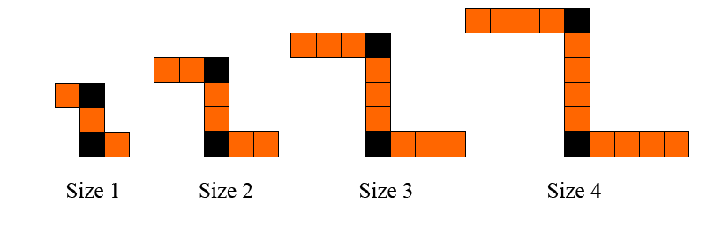
Strategy A
“Three groups of size n + 2 extra tiles” ⇒
The 2 extra tiles remain the same throughout all of the figures, while the number of tiles in the groups grows at a constant rate.

Slide 13
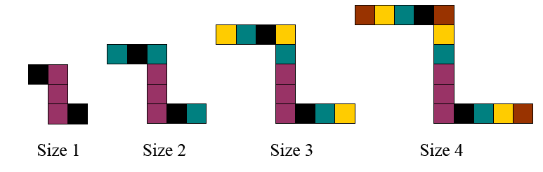
Strategy B
“n groups of size 3 + 2 extra tiles” ⇒
The 2 extra tiles remain the same throughout all of the figures, while the number of groups of three tiles grows at a constant rate.

Slide 14
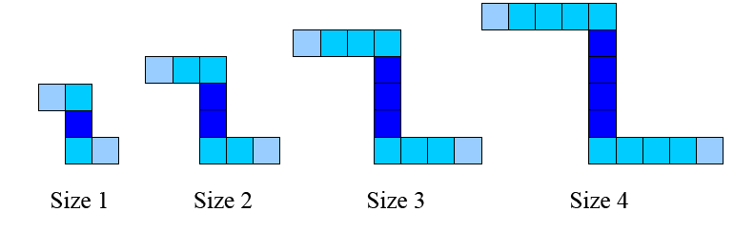
Strategy C
“A middle tower of size n + a top and a bottom (e.g., two groups) of size (n+1)” ⇒

Slide 15
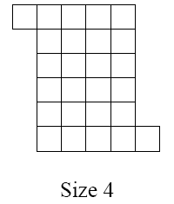
Schemel’s Logo
For the following sequence of figures, assume the pattern continues to grow in the same manner. Describe what the n^{th} figure will look like, and represent that with a rule or formula. Compare this logo to Regina’s Logo. How are they similar? How are they different?

Slide 16
Your Strategies
Notes:
Growth is two-dimensional
Squared piece, linear piece and a constant piece – attending to what’s changing and what’s staying the same
Recursive – using the previous piece

Slide 17
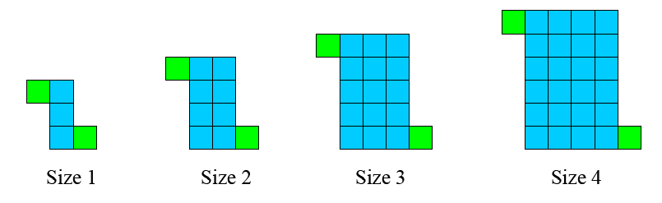
Strategy A
“the figure is made up of an n by n +2 rectangle, with 2 extra tiles added on”

Slide 18
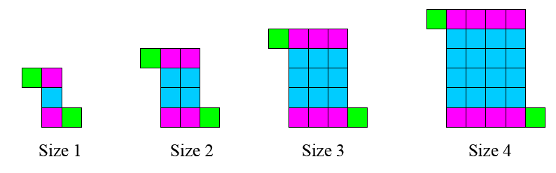
Strategy B
“the figure is made up of an n by n square, plus two groups of size n, with 2 extra tiles added on”
⇒

Slide 19
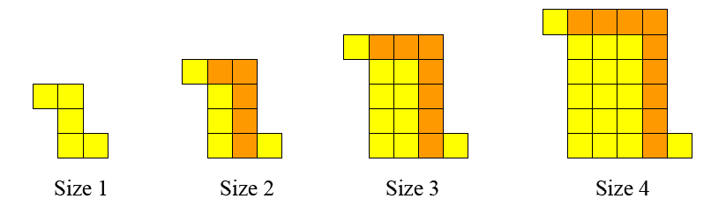
Strategy C
“the next figure is made up of the previous figure + 2n+1 tiles”
⇒
Notes:
Highlights that the change is linear!

Slide 20
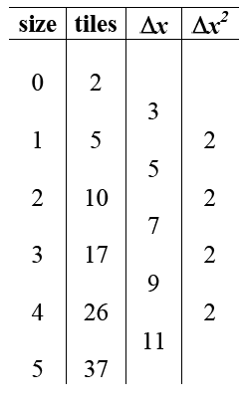
Strategy C, extended

Slide 21
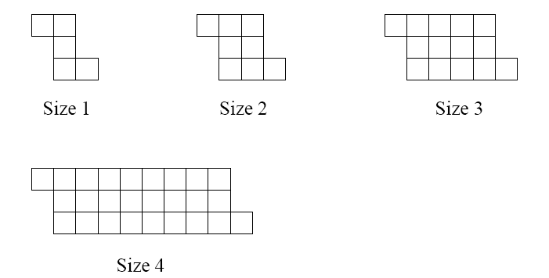
Jayson’s Logo
For the following sequence of figures, assume the pattern continues to grow in the same manner. Describe what the n^{th} figure will look like, and represent that with a rule or formula. How is this logo similar to others you have examined? How is it different?

Slide 22
Your Strategies
Notes:
Want to see the doubling, but it’s 2^{n-1}
Differences in the rate of change, particularly that the rate of change is exponential

Slide 23
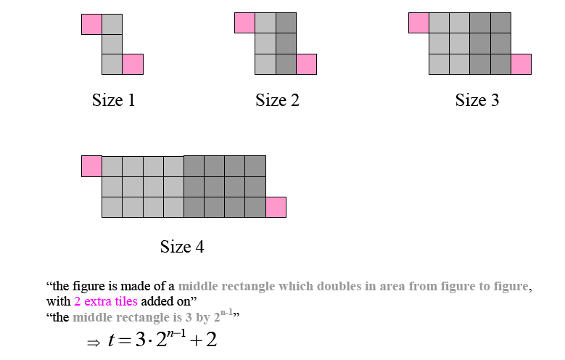
Strategy A
“the figure is made of a middle rectangle which doubles in area from figure to figure, with 2 extra tiles added on”
“the middle rectangle is 3 by 2^{n-1}”
⇒

Slide 24
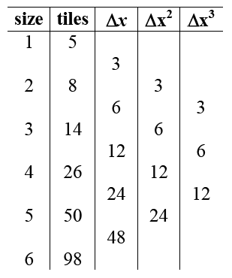
Strategy A, extended

Slide 25
Conclusions
Participant’s understanding of functions was enhanced by:
Developing a “feel” for how various families of functions grow
Starting with contextualized models that captured the essence of change for each particular type of function
Examining functions through both recursive and explicit definitions simultaneously

Slide 26
Conclusions
Participants’ understanding of functions was enhanced by:
Starting with sequences before examining related continuous functions
Using contexts that could be revisited to develop new ideas.
Writing symbolic descriptions that first attended to the features of the context, rather than the standard form of the function equation.

Slide 27
Conclusions
Participants’ understanding of functions was enhanced by:
Making connections between the visual patterns, verbal descriptions, data tables viewed in ways that highlight growth, and equations written to capture the various depictions of growth
Developing underpinnings of Calculus relating rates of change and accumulated change

Slide 28
Conclusions
Participants’ understanding of functions was enhanced by:
Developing a dynamic view of functions, moving beyond a static view
Static view:
Focus on form : equation looks like y = mx + b or
y = ax² + bx +c or y = a.b^{x}
Focus on shape of graph
Function treated as a collection of individual points
Dynamic view:
Focus on descriptions of how functions change and rates of change
Function treated as the relationship among a collection of points

