Slide 1
Realizing the Vision of the Common Core Standards
Mathematics Vision Project
www.mathematicsvisionproject.org
Notes:
Hi, I am excited to talk with you today concerning the Mathematics Vision Project or MVP.

Slide 2
This Presentation:
What is Mathematics Vision Project (MVP)?
How MVP materials fit the Common Core?
Review of the MVP materials.
Notes:
During this presentation we will discuss what Mathematics Vision Project is, and what educators will gain by becoming familiar with and using materials provided by the MVP team.
*This presentation will focus on the design of the materials and the frameworks on which they are based.
*Additionally we will demonstrate how the MVP materials address the criteria provided by the Core Standard authors for publishers, and * finally we will share the results of an independent review that was conducted on the MVP materials for Secondary One Mathematics.

Slide 3
WHAT IS THE MATHEMATICS VISION PROJECT?
Mathematics Vision Project is an educator-driven initiative
Built from the ground-up for Common Core
Committed to life-long learning
Notes:
*Mathematics Vision Project is an educator-driven initiative that provides first-rate curriculum and professional development resources to secondary math teachers.
*Built from the ground-up by a team of award-winning, math-loving education experts, the MVP material is flexible, engaging, and a seamless companion to the Common Core.
*Committed to life-long learning, the MVP team also offers educator training and resources to help teachers perform at their peak.

Slide 4
Who are we? Meet the MVP Team
We believe math is engaging.
We enjoy our work.
We know teachers need support.
Notes:
*Our desire is to enable educators to teach their students through accessible, engaging, supportive curriculum.
*Our product has grown out of our passion for teaching mathematics and we love sharing it with our clients.
*We live the phrase “we’re in this together.” As educators face new challenges and requirements, we’re there to support their next steps and, in turn, the success of their students.

Slide 5
What sets us apart from traditional publishers?
Built from the ground-up for the Common Core Standards.
Our materials are focused on learning progressions.
Our curriculum is free and published under a Creative Commons license. Additional supports also available mathematicsvisionproject.org
Notes:
*MVP materials are built from the ground-up to embody the focus, coherence, and rigor of the Common Core and immerse students in the Standards for Mathematical Practice. We have not taken previously created materials or texts and shifted them around and then repackaged them with a new cover. All of our materials are written with the content standards and mathematical practice standards in mind.
*The frameworks on which MVP materials are based are designed in accordance with the research and understandings of learning progressions in mathematics. The materials are based on research with respect to how students learn mathematics as well as the key ideas for how knowledge is organized and generated within the discipline of mathematics. The MVP team offers professional development to support those implementing the materials and provide them with a deeper understanding of the frameworks on which the materials are based.
*Unlike traditional publishers the MVP student materials are free and published with a Creative Commons License. The student materials were developed and published in partnership with the Utah State Office of Education. There are other ancillary items that have been developed which are available for purchase as well as professional development options that are also available. You can find out more about this on the MVP website, mathematicsvisionproject.org

Slide 6
How are our materials designed?
The underlying design of the materials distinguishes between problems and exercises
Each problem or exercise has a purpose
Assignments are purposefully designed
“Lessons have a few well-designed problems that progressively build and extend understanding.”
(K-8 Publishers’ Criteria for the Common Core Standards in Mathematics)
Notes:
*The materials are designed to promote a depth of knowledge and conceptual understanding. One way this is accomplished is through the use of both problems and exercises.
*Both of these have an intended purpose, which include: teaching new knowledge, surfacing misconceptions, building fluency with skills and engaging students in mathematical practices.
*This is directly in response to the criteria set forth for publishers by the Common Core authors.

Slide 7
For Example:
Problem
Exercises
Notes:
This table of contents from Module 4 of Secondary Math 1, as with all of the other modules you will find by MVP, has the classroom tasks clearly labeled. The classroom tasks fit the description of what is referred to as a “problem” by the Core Authors Publisher’s criteria. Ready, Set, Go Homework assignments are also labeled clearly and are coupled with the classroom tasks. The Ready, Set, Go Homework assignments fit the description of what is referred to as exercises by the core authors Publisher’s criteria.

Slide 8
In-Class Tasks and Ready-Set-Go Assignments
Notes:
This task from Secondary Two like all MVP Classroom Tasks is intended to be facilitated by the teacher. The teacher’s role is crucial with respect to orchestrating the discourse and assuring that mathematical goals are accomplished. The tasks promote and even require students to dig in and build understanding. The teacher facilitates this learning and guides the students’ work.

Slide 9
In-Class Tasks and Ready-Set-Go Assignments
Notes:
The Ready, Set, Go homework is intended to reinforce what has happened in class. Each section of the Ready, Set, Go has a purpose. The Ready is intended to review some mathematics and activate background knowledge that will prepare the students for upcoming in class work. The Set is intended to contain exercises that connect with the in class work that was just done in effort to allow students opportunity have this new knowledge become set in their minds. And the Go is to be things that students are good to Go on. Meaning skills and concepts that need to be reviewed and kept fresh but that students should have down.

Slide 10
A Multi-tasking Approach to Learning
Because the materials are built from the ground-up, every standard is fully addressed
Each standard is addressed in more than one task.
Each task addresses more than one standard.
Materials cannot match the contours of the standards by approaching each individual content standard as a separate event.
(K-8 Publishers’ Criteria for the Common Core Standards in Mathematics)
Notes:
*In addition to the dual facets of “problems”, and “exercises” the MVP materials exemplify a multi-tasking approach to learning. *This means that the content and practice standards are addressed in multiple tasks and that * multiple standards are also addressed in a single task.**

Slide 11
A Multi-tasking Approach to Learning
http://dl.dropboxusercontent.com/u/11459286/ccssmgraph.pdf
Notes:
This approach reflects the true nature of knowledge that is web like and connected. The MVP materials allow for multiple experiences of the same standard and promote access to the standards in multiple ways. It has been suggested by the Core authors as illustrated in the diagram above, that some standards are culminating standards and several standards need to flow into them. The MVP author team has provided such a flow and opportunities for coherent and deep learning to occur.

Slide 12
For Example:
The same standards appear in multiple tasks
Multiple standards appear in the same task
Notes:
The multi-tasking approach is evident on the table of contents of the MVP materials.
As students move through a progression of tasks the standards are developed in a meaningful way and therefore are part of multiple tasks. At the same time a single task contains the opportunity to address multiple standards.

Slide 13
Tasks are sequenced using the Comprehensive Mathematics Instruction framework.
Develop Understanding tasks surface student thinking
Solidify Understanding tasks examine and extend student thinking
Practice Understanding tasks build fluency
Develop Understanding
Solidify Understanding
Practice Understanding
Notes:
As mentioned, the in-class tasks flow or progress in a meaningful way. To guide the learning and promote a depth of understanding the Comprehensive Mathematics Instruction framework is used. This framework has grown out of research done at Brigham Young University related to how students learn mathematics. A major component of the framework is the learning cycle. The learning cycle identifies three stages of learning: Develop Understanding, Solidify Understanding and Practice Understanding. The tasks in our materials follow this progression of learning and foster reasoning and sense making.
*We begin with Develop understanding tasks, which are meant to surface student thinking and invite intuitive approaches to mathematical problems.
*Next students engage in Solidify understanding tasks. Solidify understanding tasks are designed to pursue student thinking that surfaced previously and extend it towards greater clarity and depth.
*Solidify understanding tasks are followed by Practice understanding tasks which promote fluency and efficiency, connect student thinking to mathematical conventions and the work of the broader community of mathematical practice.

Slide 14
For Example:
Develop
Solidify
Practice
Notes:
Each table of contents outlines the learning cycles in the module.
Not every learning cycle is as succinct as the one labeled above. Many times a develop understanding task will surface multiple concepts that need to be solidified and practiced.
This presentation can only scratch the surface of the CMI framework and learning cycles. We recommend more in-depth professional development be provided to help you gain a richer understanding of the frameworks and make instructional decisions in accordance with these frameworks.

Slide 15
Differentiated to meet the needs of all students
Low-threshold, high ceiling tasks
Story contexts and visual representations
Tasks are designed to surface students’ intuitive understandings
Notes:
Tasks in the MVP materials naturally allow for differentiation.
*The tasks have a low-threshold and high ceiling meaning that there are access points for all students and opportunity for extensions.
*The story contexts and the visual representations as well as the teacher’s integral role in the facilitation of the tasks promote access for all students.
*This also provides students the opportunity to connect their intuitive thoughts and reasoning to mathematical concepts in a natural and progressive way. Additionally the tasks provide for engagement in all of the mathematical practices.

Slide 16
Story Contexts that Support Conceptual Understanding
Notes:
This task demonstrates a story context on which the second module of secondary one is focused. This context supports students in learning and understanding systems of linear equations and inequalities. The context allows all students to connect with the problem and the opportunity to access the mathematics.

Slide 17
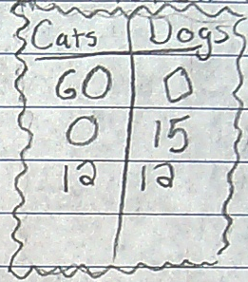
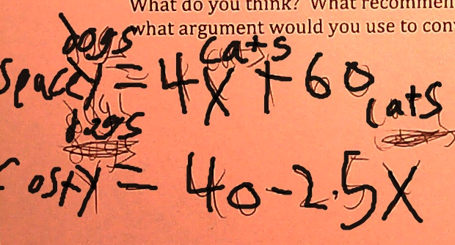
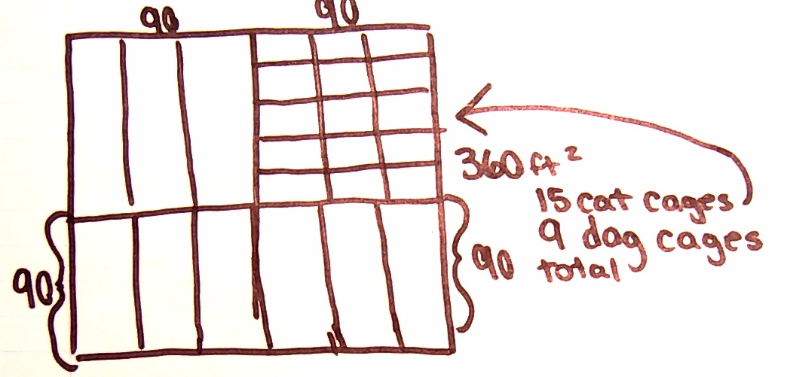
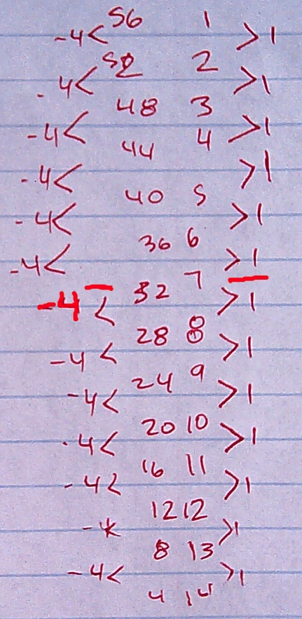
Student Work Demonstrates Multiple Access Points
Notes:
All of these pieces of student work were produced during the implementation of the Pet Sitters task and although they are not all perfectly correct they do show how students access the mathematics in various ways and intuitively take multiple approaches to the task. From all of these representations and the underlying student reasoning, subsequent work solidifies the concepts and extends the student learning.

Slide 18
Students are Immersed in Standards for Mathematical Practice
Notes:
As discussed, the learning cycle framework connects with natural learning progressions. Additionally, the learning cycle incorporates all of the mathematical practice standards as the student’s role evolves throughout the learning cycle to incorporate all of the mathematical practice standards. The Common Core standards promote versatility and flexibility as well as depth of knowledge. To promote student growth and development the MVP materials include many different experiences and different types of work for students.

Slide 19
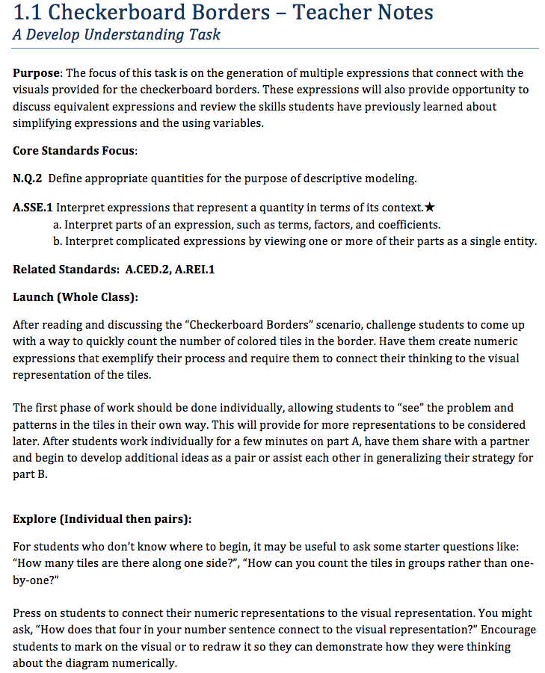
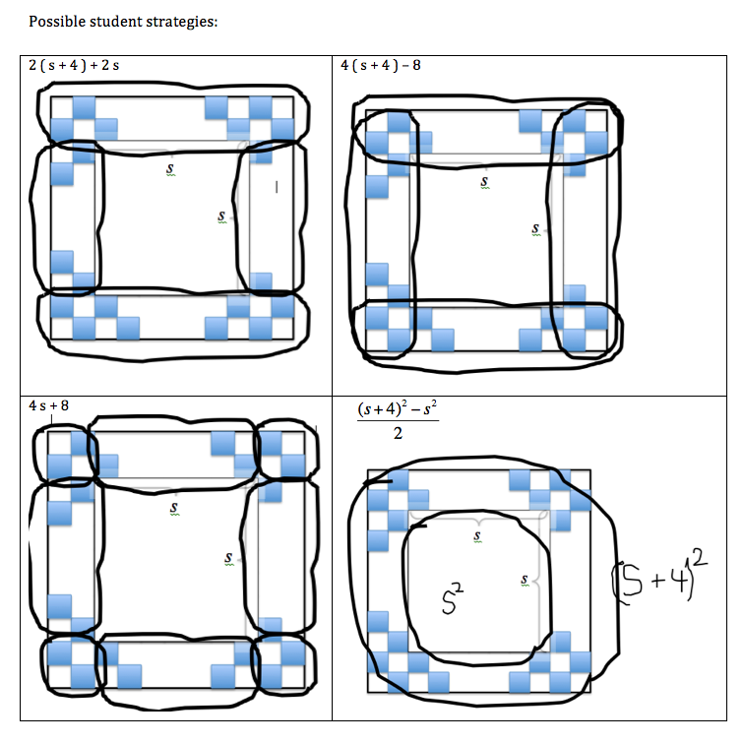
Teacher’s Role Supported with Teacher Notes
Teacher notes identify the focus for each task and provides full description of the lesson including anticipating student work, and ideas for facilitating discussions.
Notes:
The teacher’s role is of utmost importance and central to the successful implementation of the MVP materials. A masterful teacher will promote meaningful discourse and surface student’s intuitive ideas and then orchestrate a discussion in the classroom that creates a shared understanding and a deeper richer depth of knowledge for all students. This work is difficult to accomplish but with the provided teacher’s notes the MVP team has given support to teachers so that they can be more successful in their work. The MVP materials require more of students than traditional materials, they also provide students with rich opportunities for learning. In like manner the MVP materials require teachers to be well prepared and also to have a more engaging and rewarding teaching experience.

Slide 20
Our materials reflect the High School Publishers’ Criteria for Common Core State Standards for Mathematics
Notes:
The Common Core authors have provided a guide to publishers’ for the production of materials that would reflect the Core standards. The MVP materials exemplify the criteria set forth in this document.

Slide 21
Focus, Coherence, Rigor and Balance (HS Publishers Criteria for CCSSM, 2013)
Focus: where the standards focus.
Coherence: think across grades, and link to major topics in each grade
Rigor: in major topics, pursue with equal intensity
conceptual understanding,
procedural skill and fluency, and
applications (modeling)
Notes:
The criteria provided are: * focus,
* coherence and
* rigor with a balance of rigor between conceptual understanding, procedural skill and fluency and applications.

Slide 22
Focus, Coherence, Rigor and Balance (HS Publishers Criteria for CCSSM, 2013)
Balance and Rigor:
The three aspects of rigor are not always separate in materials. (Fluency can be practiced in the context of applications; and brief applications can build conceptual understanding.)
Nor are the three aspects of rigor always together in materials. (Fluency requires dedicated practice to that end; conceptual understanding will not always come along for free unless explicitly taught.)
Focus and Coherence: Content and practice standards are not connected mechanistically or randomly, but instead support focus and coherence.
Notes:
The multi-tasking nature of the Mathematics Vision Project materials and the underlying framework of learning cycles is such that * several tasks promote all three aspects of rigor while yet other tasks and exercises promote specific focus on either conceptual development or procedural fluency and modeling.
* The mathematical practice standards are relied upon and have the opportunity to be utilized as an integral part of the work that students engage while doing the tasks and exercises in MVP.

Slide 23
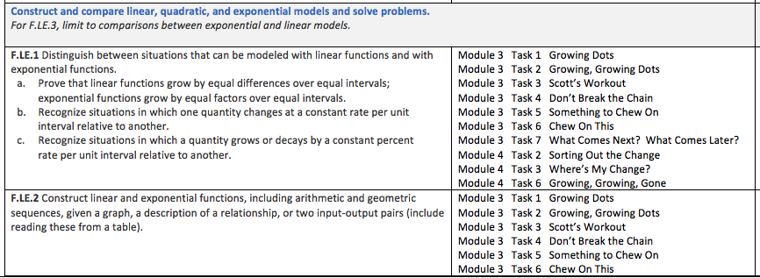
Focus
Notes:
The entire MVP curriculum is written to address the content and practice standards.
The tasks provide opportunity for learning and teaching of standards at multiple times and in multiple ways. As mentioned this is a “multi-tasking” approach.
This is illustrated in the core alignment documents found on our website.

Slide 24
Coherence
Innately part of the Learning Cycle
Thinking across grades and courses and linking major topics in each course
The standards were not so much assembled out of topics as woven out of progressions. (CCSS, Appendix)
Notes:
* The Learning Cycle framework naturally promotes coherence as tasks flow across the continuum of mathematical understanding from a stage of develop understanding to solidify understanding and then to practice understanding.
* For example, we have approached functions based on rates of change and developed multiple representations for various families of functions in the same way across the secondary courses
* The MVP materials connect algebra, functions, and geometry within and across the secondary courses.

Slide 25
Balance and Rigor
Conceptual Understanding
Procedural Skill
Fluency and Application
Develop Understanding
Solidify Understanding
Practice Understanding
Notes:
The Learning Cycle framework naturally promotes balance and rigor as tasks flow across the continuum of mathematical understanding from a stage of develop understanding to solidify understanding and then to practice understanding.
* The Develop Understanding tasks are designed to surface student thinking and intuitive conceptual understandings
* The Solidify Understanding tasks are designed to examine and extend student thinking and move student thinking toward procedural and algorithmic thinking
* The Practice Understanding tasks are designed to move student thinking towards fluency and application as defined by communities of practice outside the classroom

Slide 26
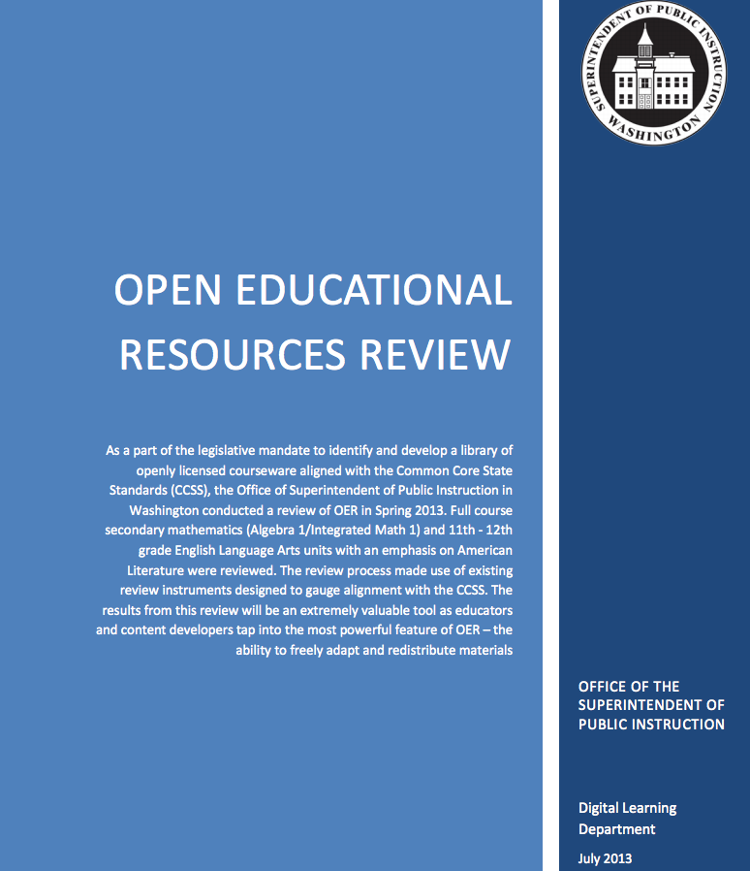
Independent Review of MVP: Washington State, July 2013
MVP leads the way in Open Education Resources
Click to image to view
Full report
Notes:
An independent review of the MVP materials for Secondary Math One was conducted by the office of the superintendent of public instruction in the state of Washington.
They reviewed several Open educational resources available for the Secondary Math One course and the MVP materials lead the way in several areas.

Slide 27
Independent Review of Our Materials
Notes:
First, when considering alignment to the standards or what the core author’s publishers criteria refers to as focus, the MVP materials out perform others.

Slide 28
Independent Review of Our Materials
Notes:
Second, with respect to the Rigor & Balance, MVP demonstrates the greatest opportunity of those materials reviewed for promoting conceptual understanding, procedural skill and fluency as well as applications.

Slide 29
Independent Review of Our Materials
Notes:
Third, MVP materials provide a strong opportunity for students to engage in deeper learning that promotes greater levels of understanding and immersion in the mathematical practice standards.

Slide 30
Independent Review of Our Materials
Notes:
Finally, the review indicated that MVP materials are preferred in comparison to other open educational resources reviewed.
Teachers agree that the MVP materials are classroom worthy.

Slide 31
What sets MVP apart?
Our materials are created from the ground-up to embody the focus, coherence, and rigor of the Common Core and immerse students in the Standards for Mathematical Practice.
Our materials respect what is known about how students learn mathematics as well as the key ideas for how knowledge is organized and generated within the discipline of mathematics.
Our curriculum is free and published under a Creative Commons license. Other support materials and professional development are available at mathematicsvisionproject.org
Notes:
In summary we would like to reemphasize that the MVP materials are different than those offered by traditional publishers.
* MVP materials have been built from the ground up to embody the focus, coherence, and rigor of the Common Core and immerse students in the Standards for Mathematical Practice
* MVP materials are based upon a framework for learning that honors student thinking and meaningful student work with respect to reasoning and sense making.
* MVP student materials and teacher notes are free, published under a creative commons license. The MVP has other support materials available and also offers professional development for teachers and teacher leaders.
We are eager to support teachers and students in their work and we hope to hear from them and from you. There are places on the mathematicsvision project website to provide feedback and we invite you to sign up for MVP updates so you can receive email notification of professional development institutes and material releases as.

Slide 32
Realizing the Vision of the Common Core Standards
Mathematics Vision Project
www.mathematicsvisionproject.org

