Slide 1
Welcome
Open the envelopes at your table and sort the strips into categories.
After sorting, give a title or label to each category.

Slide 2
Addressing the Perfect Storm: Professional development for secondary teachers focused on reasoning and sense-making
Scott Hendrickson, Brigham Young University
Joleigh Honey, Salt Lake City School District
Barbara Kuehl, Salt Lake City School District
Janet Sutorius, Juab School District

Slide 3
Vision and History of Utah State Office of Education Professional Development Projects in Secondary Mathematics
Focus on Functions
All Things Rational
Making Sense of Sense Making
Essential Understandings of the Common Core

Slide 4
Vision and History of Utah State Office of Education Professional Development Projects in Secondary Mathematics
Professional development seminar for teachers to experience mathematical content in a new way.
Each PD consists of 8 - 10 three-hour sessions with readings and assignments.
Each session has a pedagogical goal and a mathematical goal.

Slide 5
Vision and History of Utah State Office of Education Professional Development Projects in Secondary Mathematics
PD Goals
To develop mathematical understanding based upon connecting various representations-algebraic, geometric, numeric, graphical, story contexts
To experience problem-based pedagogy with discussion of rich tasks designed to elicit big mathematical ideas
To challenge the procedural view of doing mathematics and develop a more relational view

Slide 6
Goals for Today’s Session
Engage in a portion of the “Focus on Functions” PD related to the Common Core State Standards
Consider the implications of adopting the Common Core State Standards with the perspective of NCTM’s high school focus on reasoning and sense making
“These standards are not intended to be new names for old ways of doing business.” (CCSS)

Slide 7
Sorting Task
Share categories.
Sources of statements represent two decades of mathematics education reform.

Slide 8
Standards for Mathematical Practice
Make sense of problems and persevere in solving them.
Reason abstractly and quantitatively.
Construct viable arguments and critique the reasoning of others.
Model with mathematics.
Use appropriate tools strategically.
Attend to precision.
Look for and make use of structure.
Look for and express regularity in repeated reasoning.

Slide 9
Reasoning and Sense Making (NCTM 2009)
Sense Making: "We define sense making as developing understanding of a situation, context, or concept by connecting it with existing knowledge.”
Reasoning: “Reasoning can be thought of as the process of drawing conclusions on the basis of evidence or stated assumptions."

Slide 10
Content from the Common Core
Some of the domains and standards in the conceptual category of algebra :
Seeing structure in expressions
Interpret the structure of expressions.
Write expressions in equivalent forms.
Choose and produce an equivalent form of an expression to reveal and explain properties of the quantity represented by the expression.
Creating equations
Create equations that describe . . . relationships.
Create equations in two or more variables to represent relationships between quantities.
(italics added for emphasis)

Slide 11
Content from the Common Core
Some of domains and standards in the conceptual category of functions:
Interpreting functions
Interpret functions that arise in applications in terms of the context.
For a function that models a relationship between two quantities, interpret key features of graphs and tables in terms of the quantities.
Building functions
Build a function that models a relationship between two quantities.
Determine an explicit expression, a recursive process, or steps for calculation from a context.
Linear, quadratic, and exponential models
Construct linear and exponential functions, including arithmetic and geometric sequences, . . .
(italics added for emphasis)

Slide 12
Sources for Tasks
Tasks were modified and extended from:
Learning and Teaching Linear Functions
Seago, N., J. Mumme, and N. Branca, 2004. Portsmouth, NH: Heinemann
DMI: Patterns, Functions, and Change
Schifter, D., V. Bastable, and S. J. Russell, 2008. Dale Seymour Publications
Integrated Mathematics Program (IMP)
Fendel, D. M., D. Resek, L. Alper and S. Fraser, 1999. Key Curriculum Press
Tasks were facilitated with different purposes than the authors’ original intent.

Slide 13
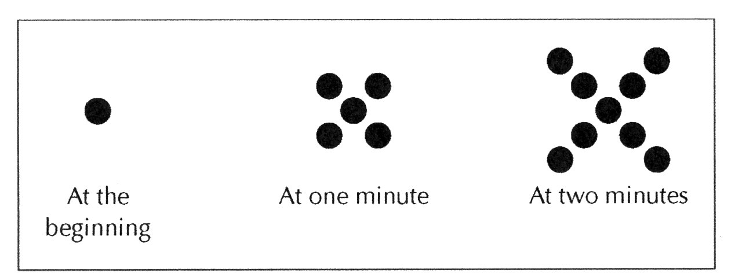
Growing Dots
Describe the pattern that you see in the above sequence of figures. Assuming the sequence continues in the same way, how many dots are there at 3 minutes? 100 minutes? t minutes?

Slide 14
Your Strategies
Notes:
Want to look at how the notation captures the participants’ words
How the different counting strategies highlight what’s changing and what’s staying the same
Recursive vs explicit and connections between functions and sequences

Slide 15
Reasoning and Sense Making
How did you engage in the Practice Standards from the Common Core or use other reasoning and sense-making strategies?

Slide 16
Perspectives on Functions
Seeing structure in expressions (CCSS)
Building functions (CCSS)
Covariation perspective: focus is on juxtaposition of two sequences with independent patterns of data; we don’t focus on rules relating x and f(x), rather we focus on patterns describing “what comes next”
Correspondence perspective: focus is on mapping elements from one set to another; often this correspondence can be represented with a rule describing “what comes n^{th}”
Developing Essential Understanding of Functions, NCTM, 2010

Slide 17
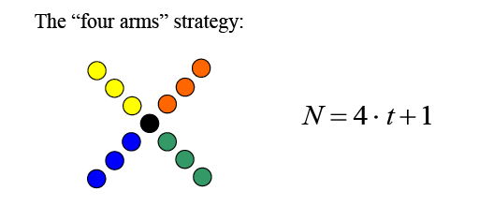
Participant Strategies: A Correspondence Structuring

Slide 18
Participant Strategies: A Covariation Structuring

Slide 19
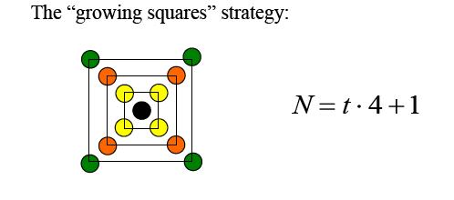
Participant Strategies: A Correspondence and Covariation Structuring

Slide 20
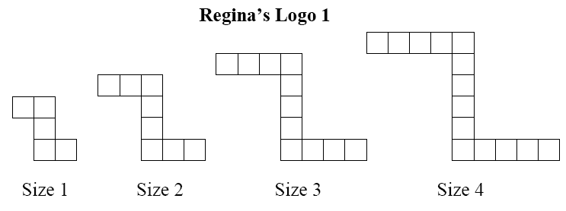
Regina’s Logo
For the following sequences of figures, assume the pattern continues to grow in the same manner. Find a rule or formula to determine the number of tiles in any size figure for that sequence.

Slide 21
Your Strategies
Notes:
Attending to the story – each equation tells a story
Constant rate of growth
What does the 3 represent in the story
What’s changing and what’s not
Where is the 3 – is the 3 groups of size 3 or 3 groups of something?
Where is the 2 in the logo?

Slide 22
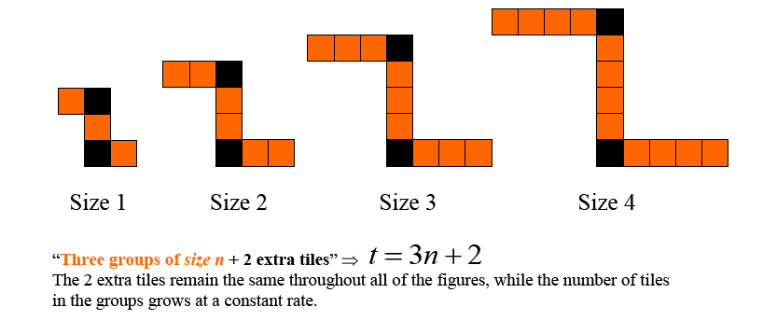
Strategy
Notes:
Does this strategy draw on a correspondence perspective or covariation perspective of functions?

Slide 23
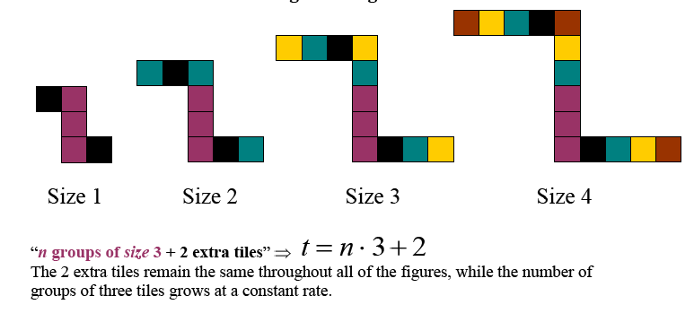
Strategy
Notes:
Does this strategy draw on a correspondence perspective or covariation perspective of functions?

Slide 24
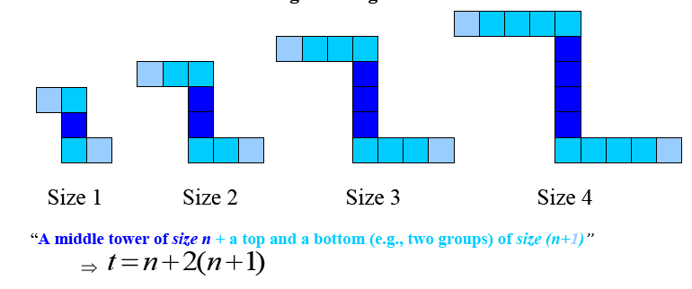
Strategy
Notes:
Does this strategy draw on a correspondence perspective or covariation perspective of functions?

Slide 25
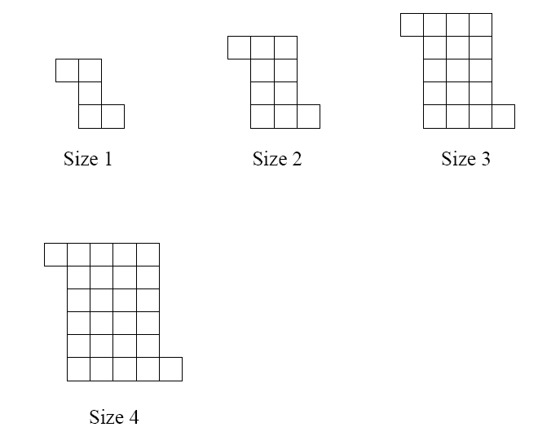
Schemel’s Logo
For the following sequence of figures, assume the pattern continues to grow in the same manner. Describe what the n^{th} figure will look like, and represent that with a rule or formula. Compare this logo to Regina’s Logo 1. How are they similar? How are they different?

Slide 26
Your Strategies
Notes:
Growth is two-dimensional
Squared piece, linear piece and a constant piece – attending to what’s changing and what’s staying the same
Recursive – using the previous piece

Slide 27
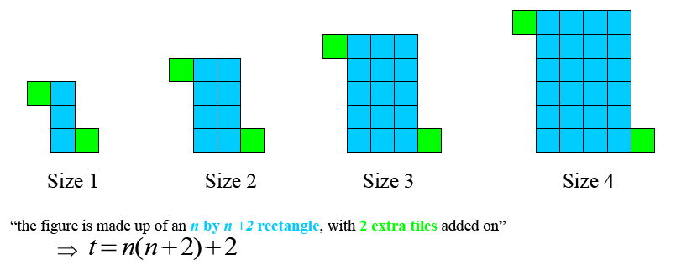
Strategy
Notes:
Does this strategy draw on a correspondence perspective or covariation perspective of functions?

Slide 28
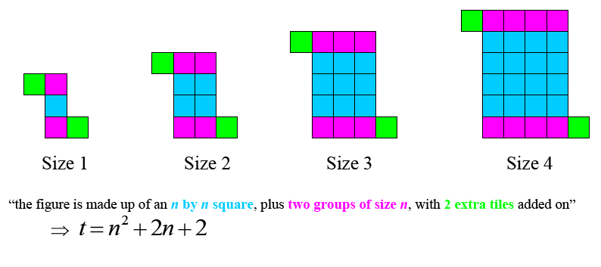
Strategy
Notes:
Does this strategy draw on a correspondence perspective or covariation perspective of functions?

Slide 29
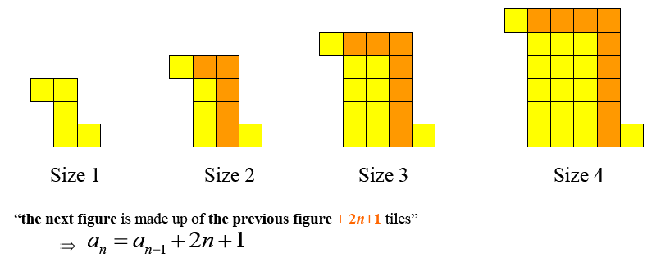
Strategy
Notes:
Does this strategy draw on a correspondence perspective or covariation perspective of functions?

Slide 30
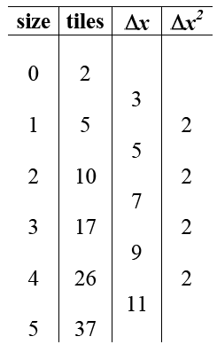
Strategy
Notes:
Rate of change grows out of the covariation perspective

Slide 31
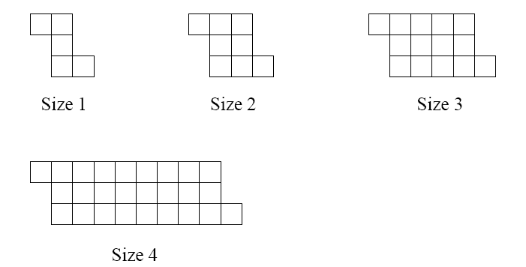
Jayson’s Logo
For the following sequence of figures, assume the pattern continues to grow in the same manner. Describe what the n^{th} figure will look like, and represent that with a rule or formula. How is this logo similar to others you have examined? How is it different?

Slide 32
Your Strategies
Notes:
Want to see the doubling, but it’s 2^{n-1}
Differences in the rate of change, particularly that the rate of change is exponential

Slide 33
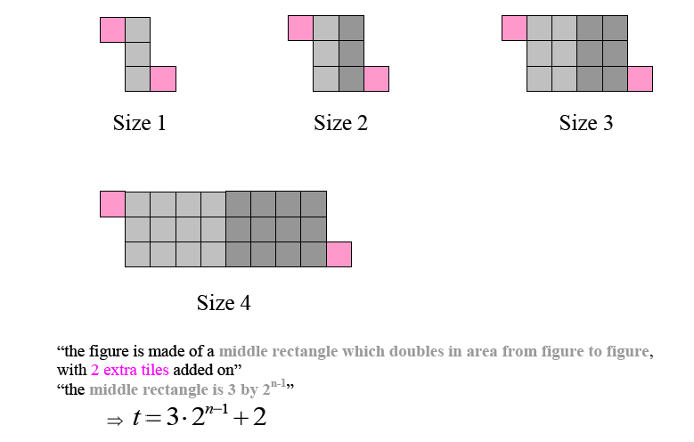
Strategy
Notes:
Does this strategy draw on a correspondence perspective or covariation perspective of functions?

Slide 34
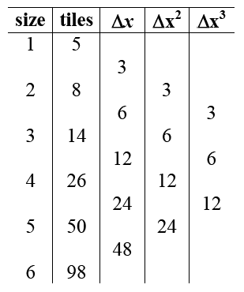
Strategy
Notes:
Does this strategy draw on a correspondence perspective or covariation perspective of functions?
Rate of change grows out of a covariation perspective.

Slide 35
Conclusions
Participants understanding of functions was enhanced by:
Providing multiple experiences to develop a “feel” for how various families of functions grow
Starting with contextualized models (rather than an equation, table or graph) that captured the essence of change for each particular type of function (e.g., the staircase towers tasks or the logos tasks)
Examining linear, quadratic, polynomial and exponential functions through both recursive and explicit definitions simultaneously, since the recursive perspective provides more direct access to rate of change

Slide 36
Conclusions
Participants’ understanding of functions was enhanced by:
Starting with sequences—non-continuous, discrete functions of the natural numbers—before examining related continuous functions (e.g., arithmetic sequences and linear functions, geometric sequences and exponential functions)
Using contexts that could be revisited to develop new ideas while drawing upon strategic ways of thinking that were established through previous experiences with the same contexts (e.g., similar logos, staircase scenarios)
Writing symbolic descriptions that first attended to the features of the context, rather than the standard form of the function equation (e.g., y = 4x + 1 and y = x•4 + 1 attend to different ways of visualizing the Growing Dots pattern, whereas the standard form for linear data, y = mx + b, does not)

Slide 37
Conclusions
Participants understanding of functions was enhanced by:
Making connections between the visual patterns of growth, verbal descriptions of those patterns of growth, data tables viewed in ways that highlight that growth (e.g., difference columns), and equations written to capture the various depictions of growth
Developing underpinnings of Calculus relating rates of change (derivatives) and accumulated change (integrals)

Slide 38
Conclusions
Participants understanding of functions was enhanced by:
Developing a dynamic view of functions, moving beyond a static view
Static view:
Focus on form : equation looks like y=mx +b or y=ax² +bx +c or y=ab^{x}
Focus on shape of graph (leading to the misconception that every “u-shaped” graph is quadratic, or an increasing, concave up piece of a graph is exponential)
Function treated as a collection of individual points (e.g., evaluate f(x) at x = 2)
Dynamic view:
Focus on descriptions of how functions change (e.g., decreasing at a constant rate, increasing at a decreasing rate) and rates of change (e.g., a quadratic grows linearly)
Function treated as the relationship among a collection of points

Slide 39
Contact Information
Barbara.Kuehl@slcschools.org
scott@mathed.byu.edu
Joleigh.Honey@slc.k12.ut.us
janet.sutorius@juab.k12.ut.us

